Slide 1


DATA COMMUNICATION
CSE 225/233
WEEK-3, LESSON-1
DATA AND SIGNAL

Slide 2
Background
To be transmitted, data electromagnetic signal.
must be transformed to
3.2

Slide 3





































Analog and Digital
Data can be analog or digital. The term analog data refers to information that is continuous; digital data refers to information that has discrete states. Analog data take on continuous values. Digital data take on discrete values.
Topics discussed in this section:
Analog and Digital Data Analog and Digital Signals
Periodic and Nonperiodic Signals
3.3

Slide 4










































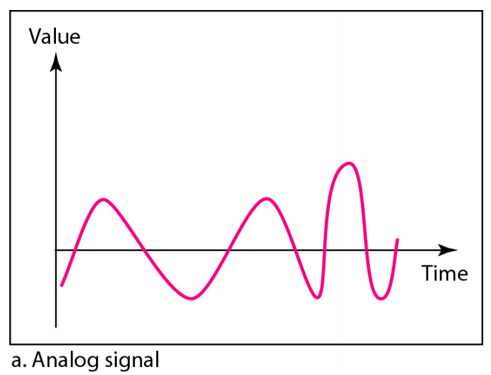
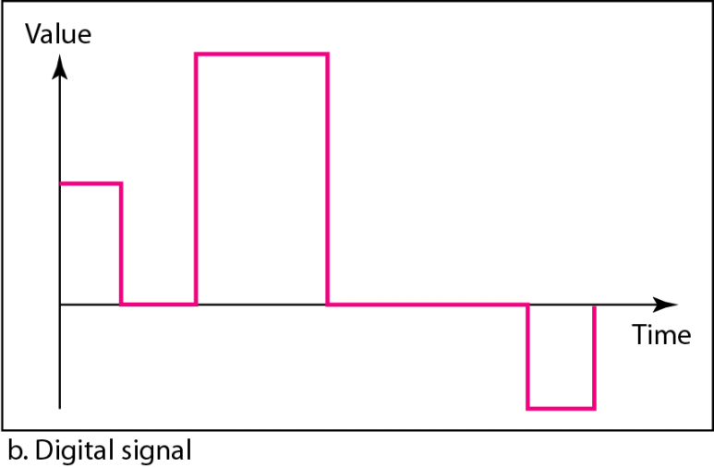
Analog and Digital (Contd.)
Data can be analog or digital. Analog data are continuous and take continuous values. Digital data have discrete states and take discrete values.
Signals can be analog or digital. Analog signals can have an infinite number of values in a range; digital signals can have only a limited number of values.
3.4

Slide 5
Periodic and Aperiodic signals
Both analog and digital signals can take one of two forms.
—Periodic: completes a pattern within a measurable time frame called a period and repeats that pattern over subsequent identical periods
—Aperiodic: Signal changes without exhibiting (Showing) a pattern or cycle that repeats over time
In data analog
communications, we commonly use signals and nonperiodic digital
periodic signals.
3.5

Slide 6












PERIODIC ANALOG SIGNALS
Periodic analog signals can be classified as simple or composite. A simple periodic analog signal, a sine wave, cannot be decomposed into simpler signals. A composite periodic analog signal is composed of multiple sine waves.
Topics discussed in this section:
Sine Wave
Wavelength
Time and Frequency Domain
Composite Signals
Bandwidth
3.6

Slide 7
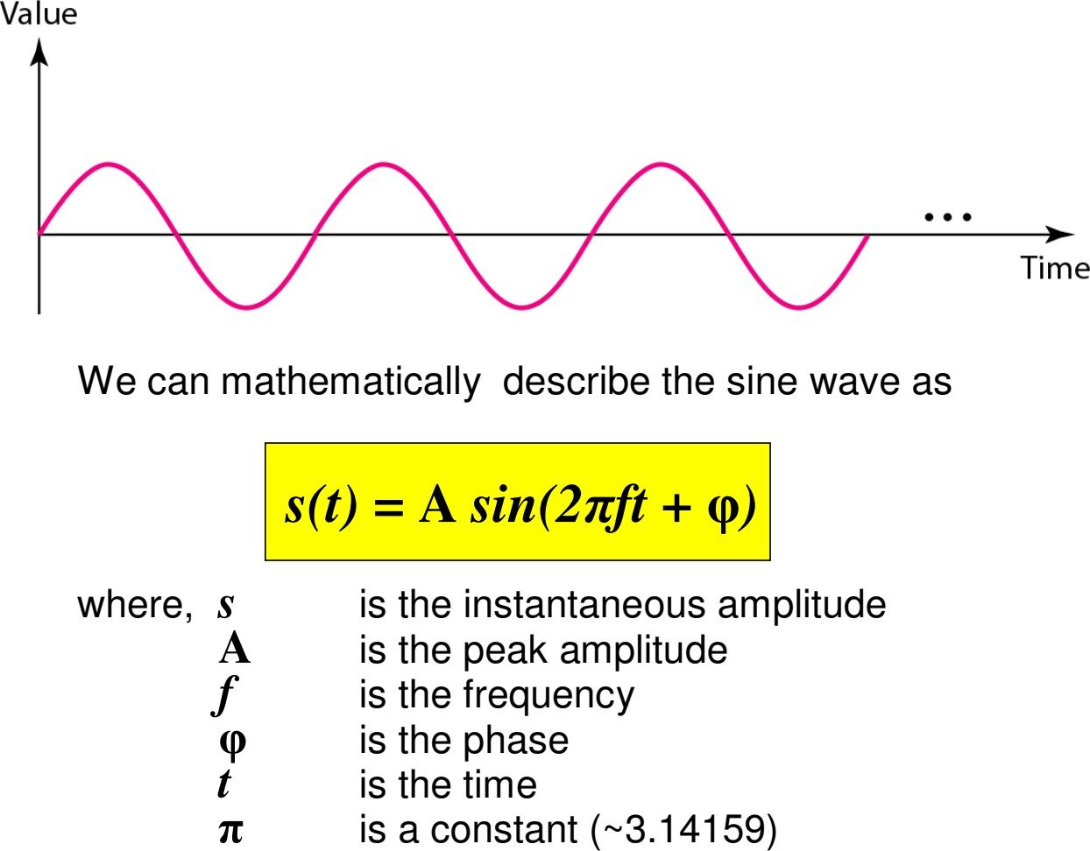
A sine wave
3.7

Slide 8
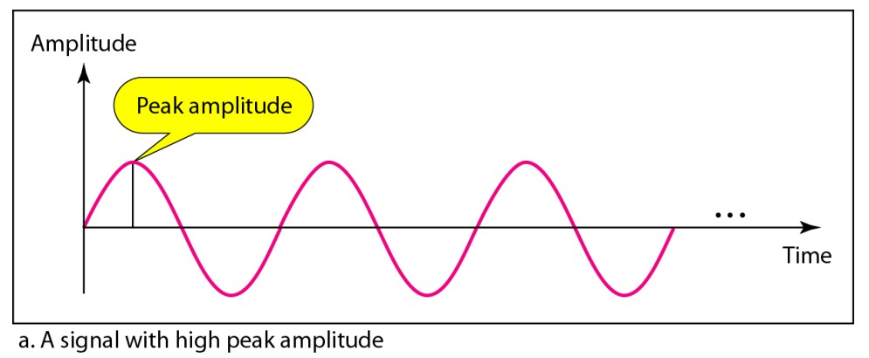
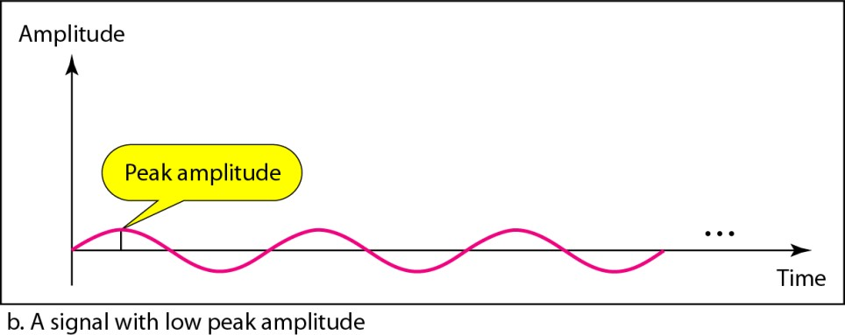
Two signals
Same phase and frequency, but different amplitude
3.8

Slide 9














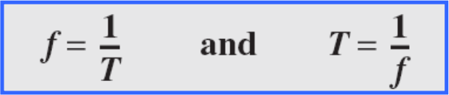
Period and frequency
Period refers to the amount of time, in seconds, a signal needs to complete 1 cycle.
Denoted by T, measured in seconds.
Frequency refers to the number of periods in one second
Denoted by f, measured in Hertz (Hz)
Frequency and period are the inverse of each other.
3.9

Slide 10
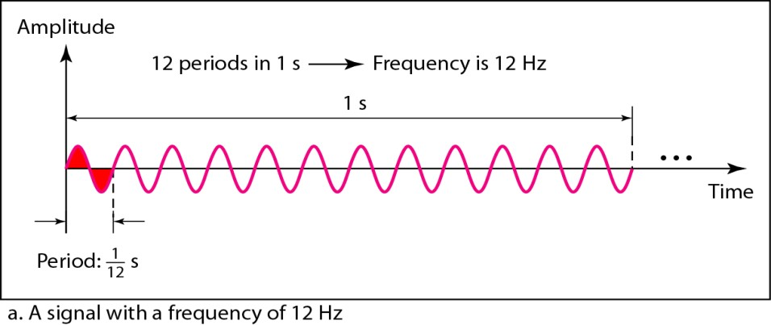
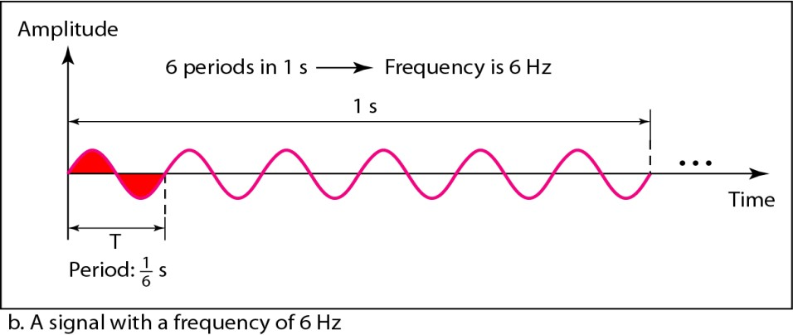
Two Signals
Same amplitude and phase, but different frequencies

Slide 11
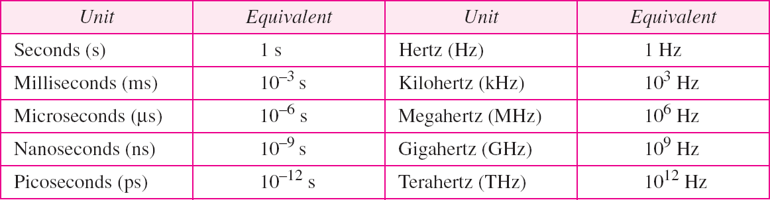
Units of period and frequency

Slide 12
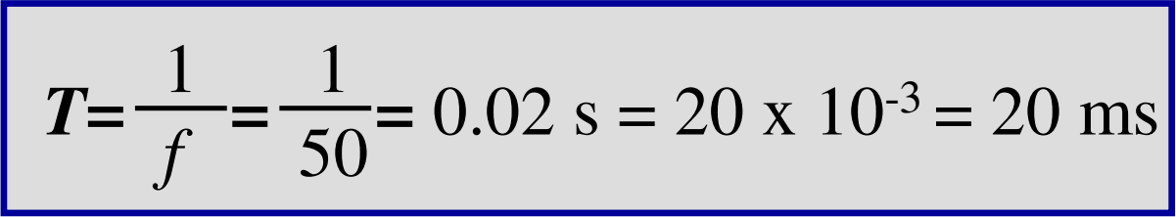
Example (1)
The power we use at home has a frequency of 50 Hz. The period of this sine wave can be determined as follows:

Slide 13
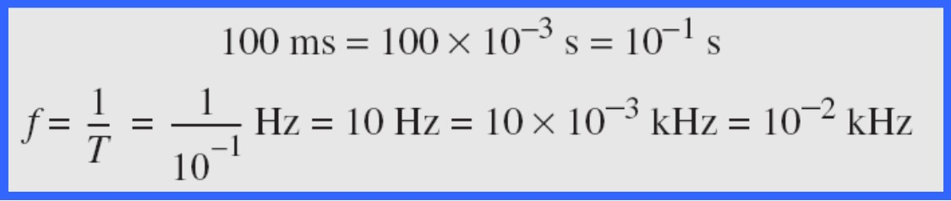
Example (2)
The period of a signal is 100 ms. What is its frequency in kilohertz?
Solution
First, we change 100 ms to seconds, and then we calculate the frequency from the period (1 Hz = 10⁻³ kHz)

Slide 14
































More about frequency
Frequency is the rate of change with respect to time. Change in a short span of time means high frequency.
Change over a long span of time means low frequency. If a signal does not change at all, its frequency is zero.
If a signal changes instantaneously, its frequency is infinite.

Slide 15












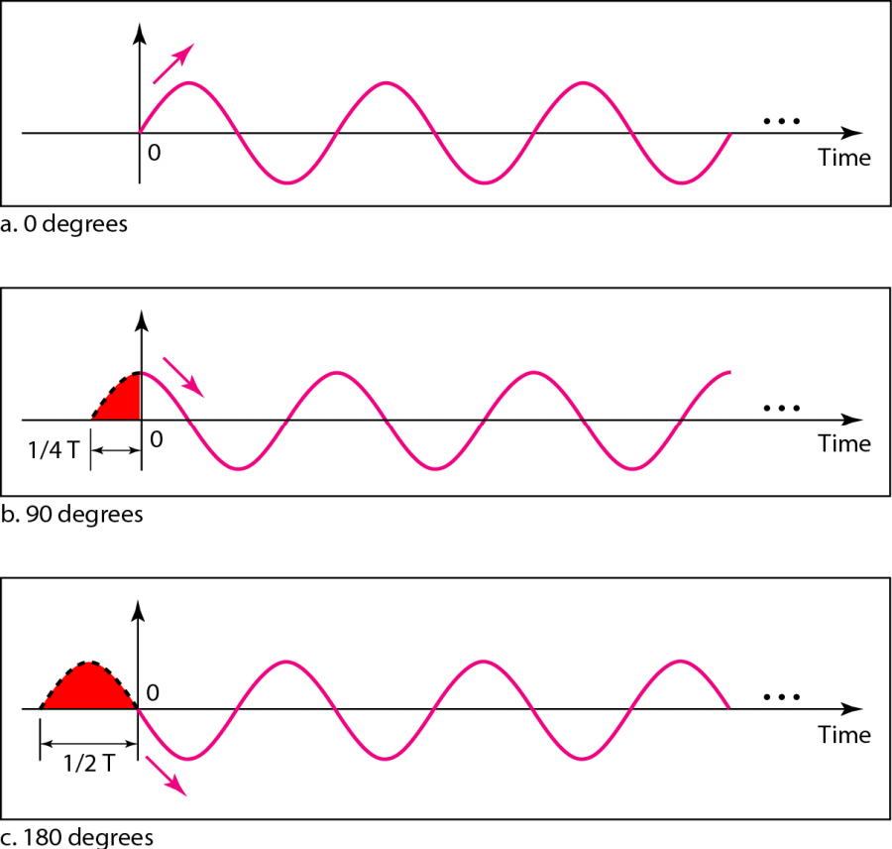
Phase
Phase describes the position of the waveform relative to time 0.
Following figure shows the Same amplitude and frequency,
but different phases.

Slide 16
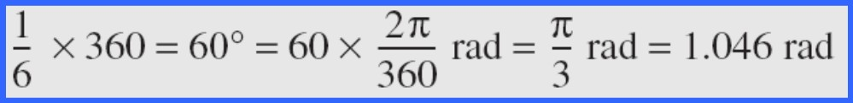
Example
A sine wave is offset 1/6 cycle with respect to time 0. What is its phase in degrees and radians?
Solution
We know that 1 complete cycle is 360°. Therefore, 1/6 cycle is

Slide 17
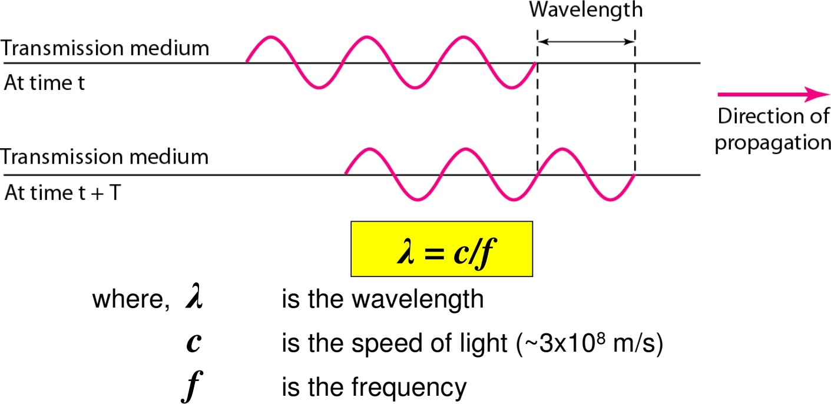
Wavelength and Period
Wavelength is another characteristic of a signal traveling through a
transmission medium.
The wavelength depends on both the frequency and the medium.
The wavelength is the distance a signal can travel in one period.

Slide 18
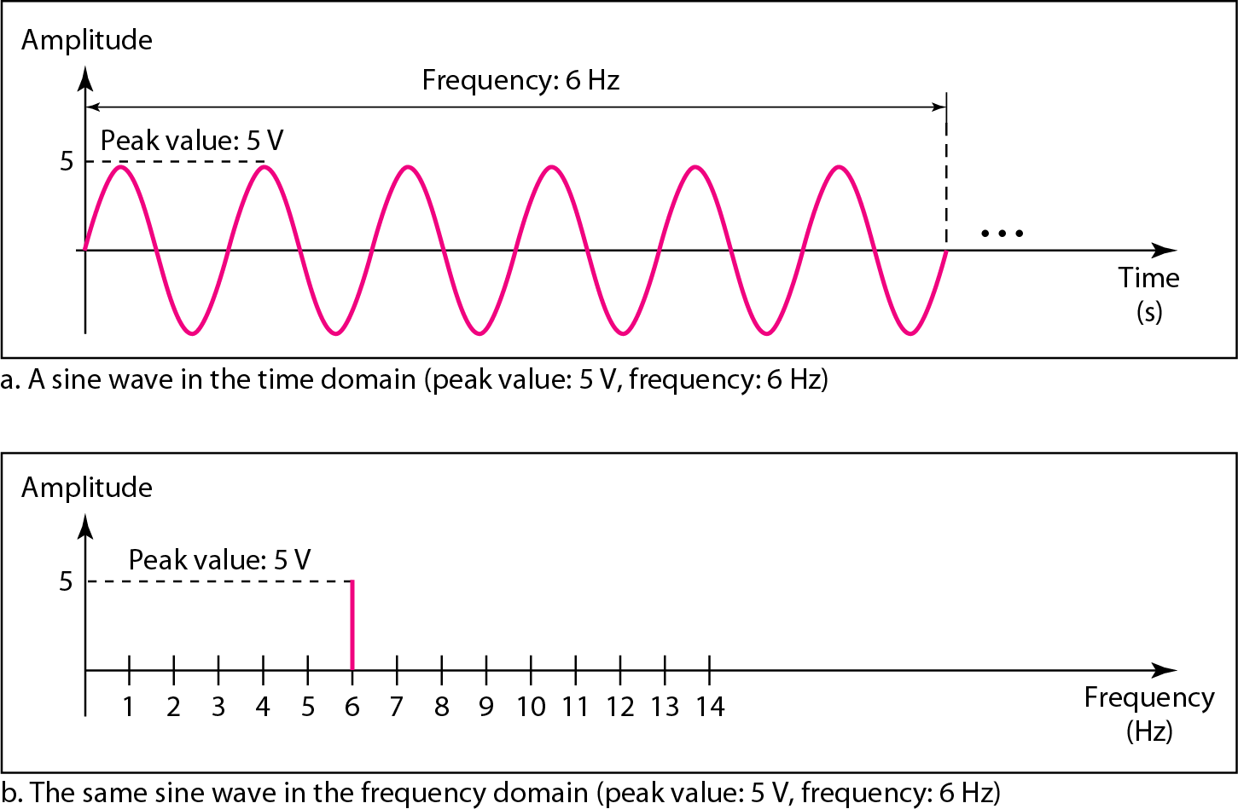
The time-domain and frequency-domain plots of a sine wave
A complete sine wave in the time domain can be represented by one single spike in the frequency domain.
3.18

Slide 19
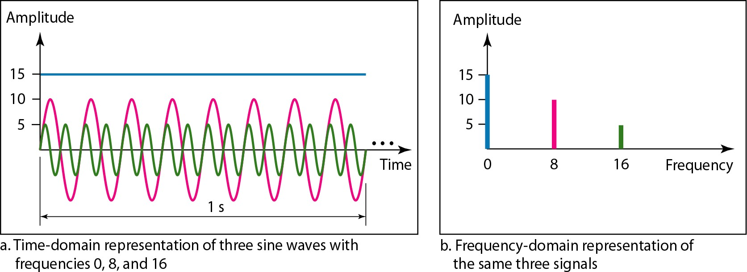
Example
The frequency domain is more compact and useful when we are dealing with more than one sine wave. For example, Figure 3.8 shows three sine waves, each with different amplitude and frequency. All can be represented by three spikes in the frequency domain.

Slide 20
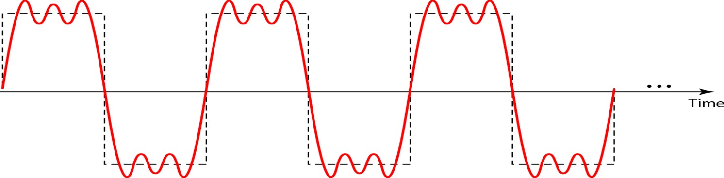
Composite Signal
A single-frequency sine wave is not useful in data communications; we need to send a composite signal, a signal made of many simple sine waves.
The figure shows a periodic composite signal with frequency f. This
type of signal is not typical of those found in data communications. We can consider it to be three alarm systems, each with a different frequency. The analysis of this signal can give us a good understanding of how to decompose signals.

Slide 21
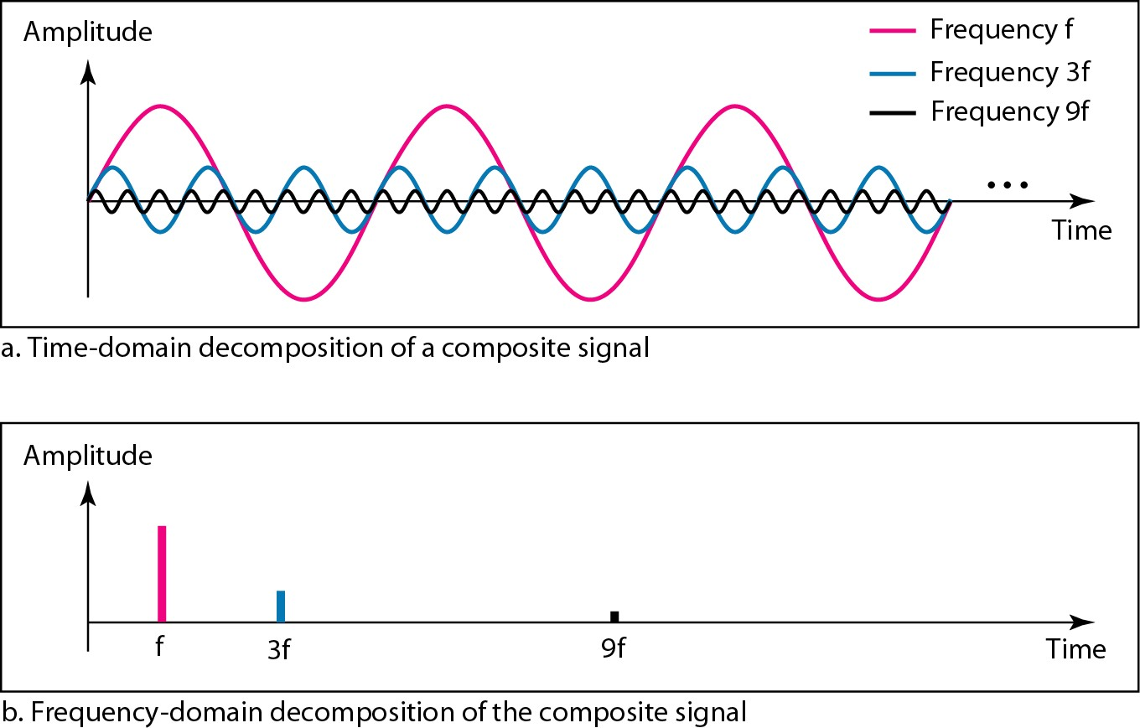
Decomposition of a composite periodic signal in the time and
frequency domains

Slide 22
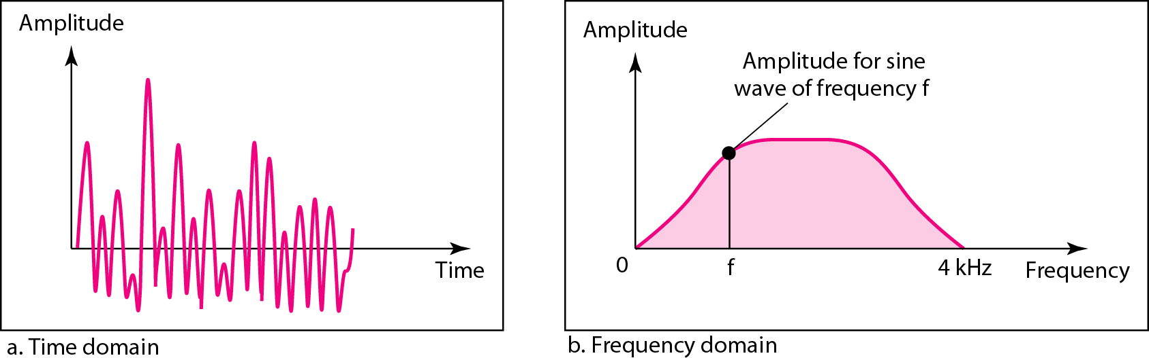
Example
Following figure shows a nonperiodic composite signal. It can be the signal created by a microphone or a telephone set when a word or two is pronounced. In this case, the composite signal cannot be periodic, because that implies that we are repeating the same word or words with exactly the same tone.

Slide 23
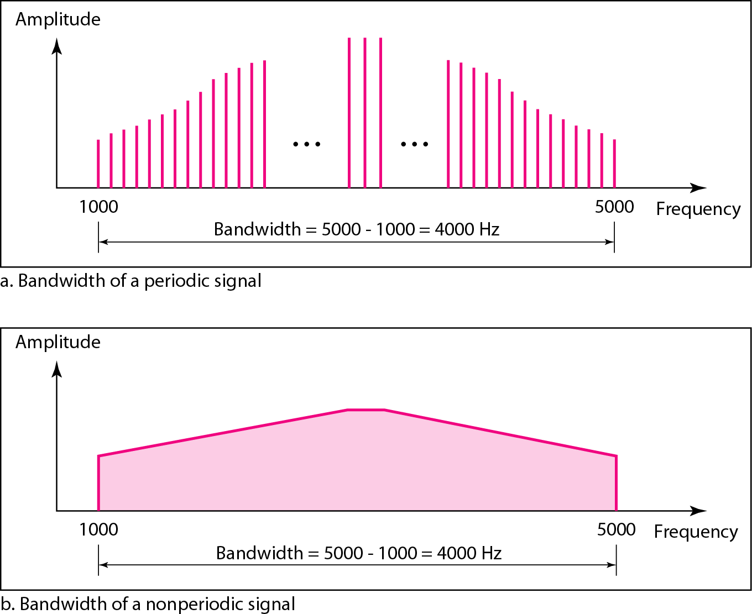
Bandwidth
The bandwidth of a composite signal is the difference between the highest and the lowest frequencies contained in that signal.

Slide 24

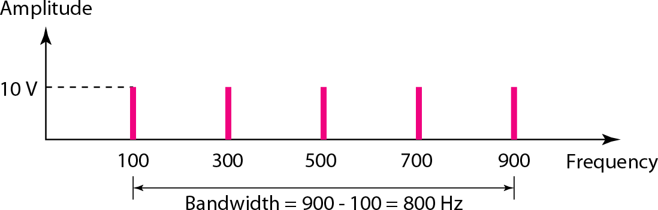
Example (1)
If a periodic signal is decomposed into five sine waves with 100, 300, 500, 700, and 900 Hz, what is its
frequencies of
bandwidth? Draw the spectrum, assuming all components have a maximum amplitude of 10 V.
Solution
Let f_{h} be the highest frequency, f_{l} the lowest frequency, and B the bandwidth. Then
The spectrum has only five spikes, at 100, 300, 500, 700, and 900 Hz

Slide 25
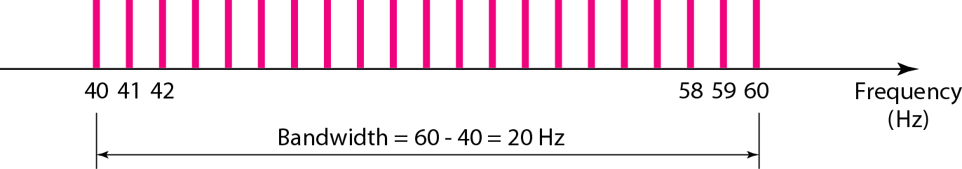
Example (2)
A periodic signal has a bandwidth of 20 Hz. The highest frequency is 60 Hz. What is the lowest frequency? Draw the spectrum if the signal contains all frequencies of the same amplitude.
Solution
Let f_{h} be the highest frequency, f_{l} the lowest frequency, and B the
bandwidth. Then
The spectrum contains all integer frequencies. We show this by a
series of spikes

Slide 26
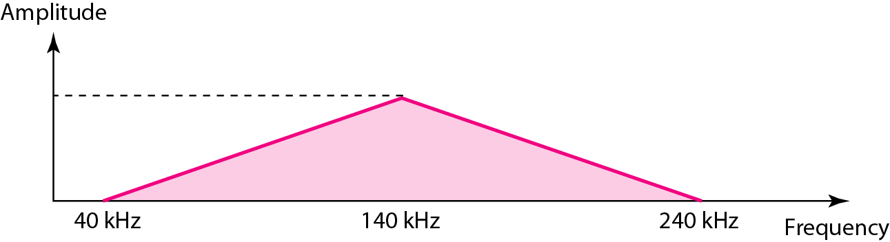
Example (3)
A nonperiodic composite signal has a bandwidth of 200 kHz, with a middle frequency of 140 kHz and peak amplitude of 20 V. The two extreme frequencies have an amplitude of 0. Draw the frequency domain of the signal.
Solution
The lowest frequency must be at 40 kHz and the highest at 240 kHz. Figure 3.15 shows the frequency domain and the bandwidth.

Slide 27



























































Digital Signal
In addition to being represented by an analog signal, information can also be represented by a digital signal. For example, a 1 can be encoded as a positive voltage and a 0 as zero voltage. A digital signal can have more than two levels. In this case, we can send more than 1 bit for each level.
Topics discussed in this section:
Bit Rate Bit Length
Digital Signal as a Composite Analog Signal Application Layer

Slide 28
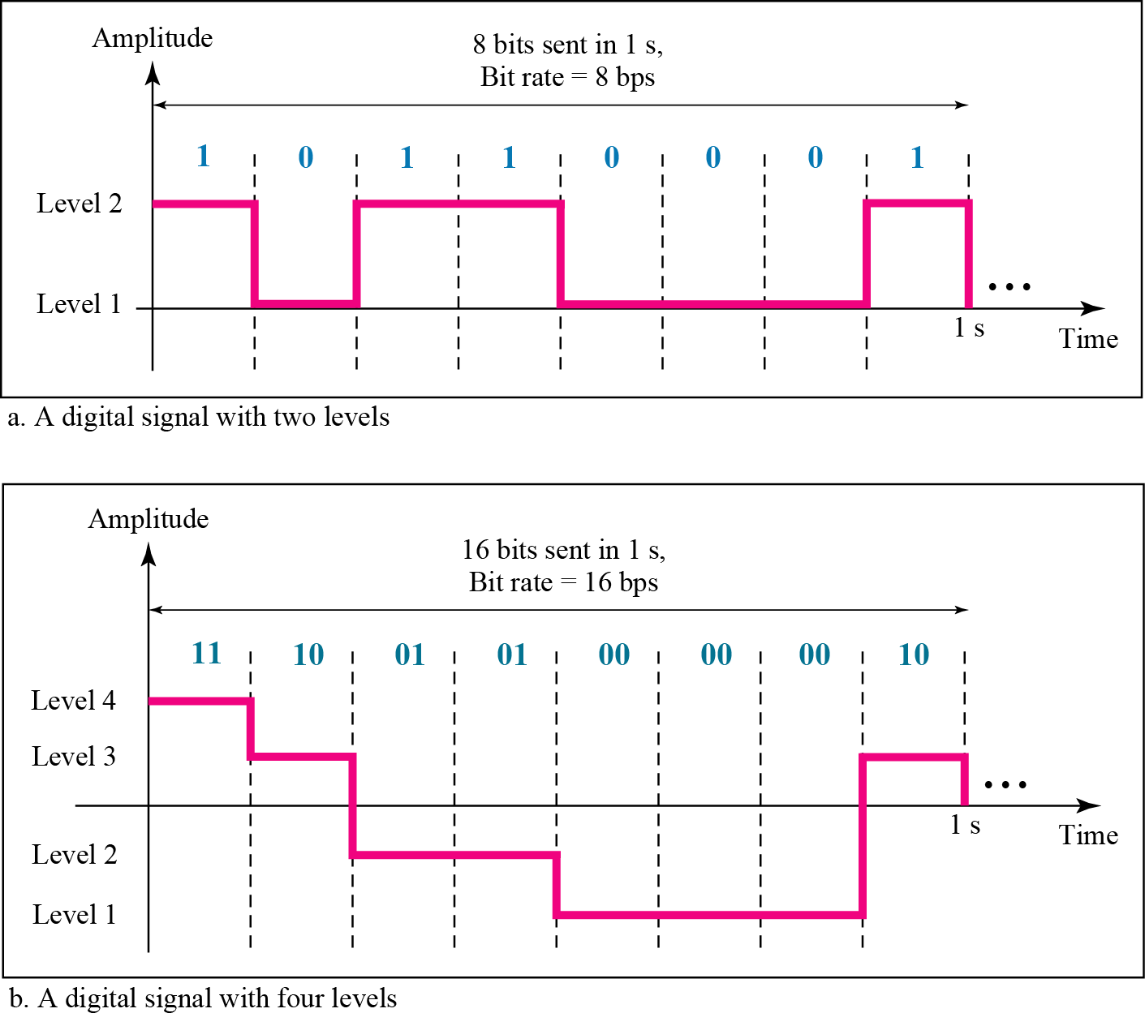
Two Digital Signals
one with two signal levels and the other with four signal levels
3.28

Slide 29

Example (1)
A digital signal has eight levels. How many bits are needed per level?
Solution
We calculate the number of bits from the formula log₂n
Each signal level is represented by 3 bits.

Slide 30
Example (2) Signal Level Vs Bits
A digital signal has nine levels. How many bits are needed per level?
Solution
We calculate the number of bits by using the formula log₂n, i.e. log₂9=3.17
So each signal level is represented by 3.17 bits. However, this answer is not realistic. The number of bits sent per level needs to be an integer as well as a power of 2. For this example, 4 bits can represent one level.

Slide 31
Bit rate and bit interval
Most digital signals are aperiodic, so the period or frequency are not appropriate.
Bit interval (instead of period) and bit rate (instead of frequency) are used to describe digital signals.
Bit interval is the time required to send one single bit
Bit rate is the number of bit intervals per second
—Usually expressed as bits per second (bps)

Slide 32
Example (3) bit rate for text
Assume we need to download text documents at the rate of 100 pages per minute. What is the required bit rate of the channel?
Solution
A page is an average of 24 lines with 80 characters in each line. If we assume that one character requires 8 bits, the bit rate is

Slide 33

Example (4) bit rate for audio
A digitized voice channel, is made by digitizing a 4-kHz bandwidth analog voice signal. We need to sample the signal at twice the highest frequency (two samples per hertz). We assume that each sample requires 8 bits. What is the required bit rate?
Solution
The bit rate can be calculated as

Slide 34
Example (4) bit rate for video
What is the bit rate for high-definition TV (HDTV)?
Solution
HDTV uses digital signals to broadcast high quality video signals. The HDTV screen is normally a ratio of 16 : 9. There are 1920 by 1080 pixels per screen, and the screen is renewed 30 times per second. Twenty-four bits represents one color pixel.
The TV stations reduce this rate to 20 to 40 Mbps through compression.

Slide 35

3.35

